Slide 1
DATA ANALYTICS PROJECT Zomato Analysis
Presented By:-
Ravi Ganesan
Saikiran
Stevenson Jacob
Rajakul Hisab
Rohan Np

Slide 2
Zomato Introduction
About Zomato : Zomato is an Indian Online food ording and delivering service owned by Eternal Limited. Created in 2008 by Deepinder Goyal and Pankaj Chaddah, it began as a restaurant aggregator, providing menu information, user reviews, and recommendations, and expanding to more than 20 countries.
Vision : "To become the most trusted platform for food and beyond."
Mission: "Better food for more people."

Slide 3
Advantages of Using Zomato
Restaurant Discovery
Users can search and discover restaurants by location, cuisine, ratings, pricing, and popularity.
Includes filters for features like "Table Booking" or "Online Delivery.“
Online Food Delivery
Enables users to order food from partner restaurants through the Zomato app or website.
Includes real-time order tracking and estimated delivery times.
Table Booking (Dine-In Reservations)
Allows users to book tables at select restaurants in advance.
Often includes offers or discounts for reservations made via Zomato.
Reviews and Ratings
User-generated reviews and ratings for restaurants and dishes.
Includes photos and detailed feedback that guide new customers.
Grocery and Essentials Delivery (Zomato Market)
Launched during the COVID-19 pandemic in select cities for essentials delivery.
Not always active, varies by location.

Slide 4
Data Analysis & Zomato Analysis
Data analysis : It is the process of inspecting, cleansing, transforming, and modeling data with the goal of discovering useful information, informing conclusions, and supporting decision-making
Zomato Analysis :The goal of this analysis is to uncover insights into restaurant distribution, customer preferences, and service features across various cities and countries. By exploring key metrics such as restaurant ratings, pricing levels, availability of services like online delivery and table booking, and geographic trends, this analysis aims to assist stakeholders in making informed decisions related to marketing strategies, business expansion, and customer engagement. The findings are visualized using dashboards and charts for better understanding and actionable insights.

Slide 5
Technologies Used for Zomato Analysis
Microsoft Excel
Tableau
Microsoft PowerBI
MySQL

Slide 6
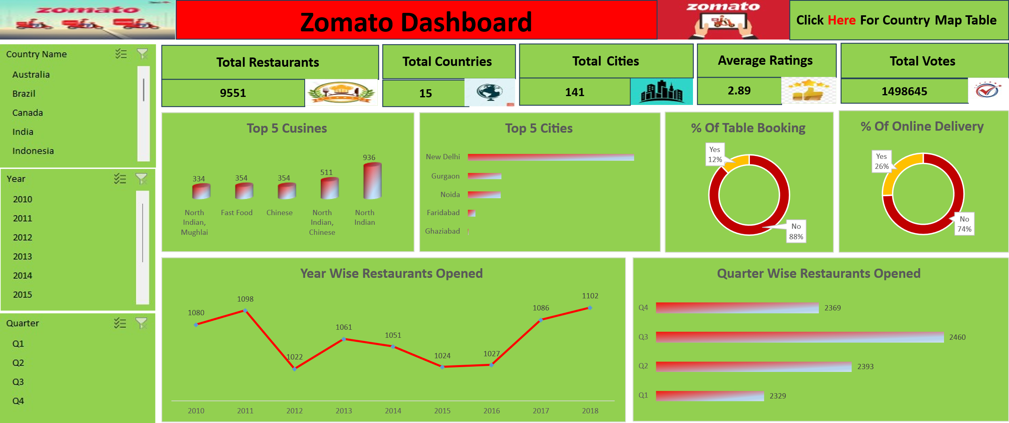
MICROSOFT EXCEL
Introduction : Microsoft Excel is a powerful spreadsheet application developed by Microsoft, widely used for data organization, analysis, and visualization.

Slide 7
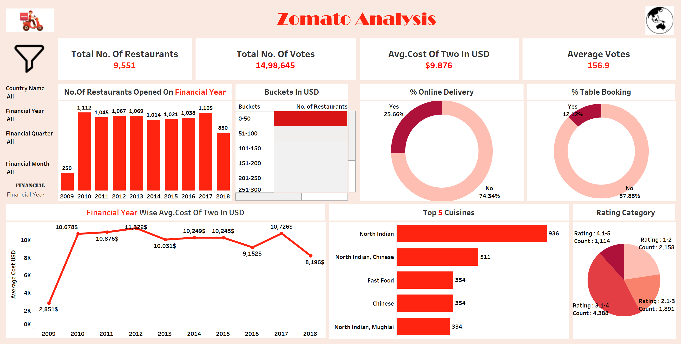
TABLEAU
Introduction : Tableau is a powerful tool for data analysis and interactive visualization, requiring no coding. It quickly transforms data into insights to support informed decision-making.

Slide 8
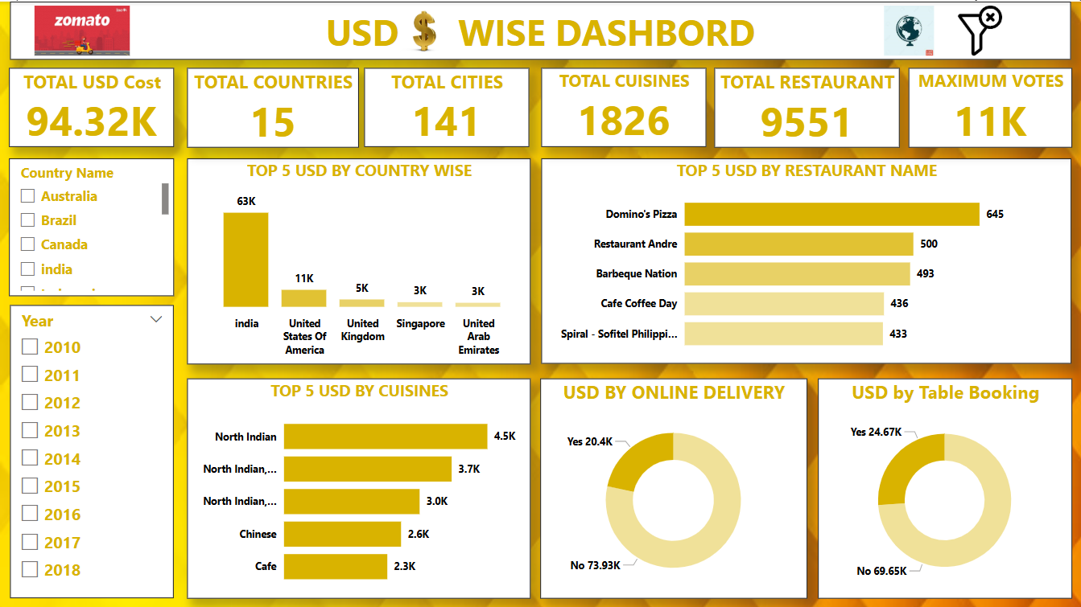
Microsoft Power Bi
Introduction : Power BI is a Microsoft business intelligence tool for analyzing and visualizing raw data. It combines analytics and visualization to support data-driven decisions.

Slide 9
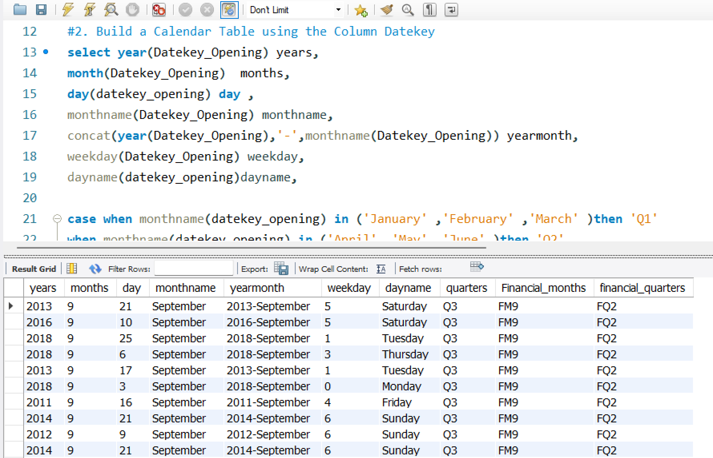
My Structured Query Language
Introduction : MySQL is an open-source RDBMS that uses SQL to manage data efficiently. It's popular for its speed, reliability, and integration with languages like PHP, Java, and Python.
1 - create, insert and join queries used for this question.
2 - create, year, month, Concat, dayname, case.
3- join, limit, group, count function and order used.
4-year,month, quarter, count function.
5-average and count functions.
6- Case and count functions.
7- percentage and count functions.
8- percentage and count functions.

Slide 10
Advantages and Challenges
Excel
Power Bi
Advantages :
User-Friendly Interface.
Widespread Availability.
Built-in Functions.
Visualization Tools.
Data Organization.
Pivot Tables.
Add-ins and Extensions.
Disadvantages:
Limited Scalability.
Error-Prone.
Lack of Advanced Analytics.
Version Control Issues.
Data Integrity Risks.
Security Concerns.
Limited Automation.
Advantages:
Affordability.
Custom Visualizations.
Excel Integration.
Data Connectivity.
Power BI Embedded.
Disadvantages :
Limited Scalability.
Error-Prone.
Lack of Advanced Analytics.
Version Control Issues.
Data Integrity Risks.
Security Concerns.
Limited Automation.

Slide 11
Advantages and Challenges
Tableau
MYSQL
Advantages :
Tableau is a data visualization platform.
Quickly Construct Interactive Visualisation.
Tableau Can handle Large Amounts of Data.
Tableau can use various scripting languages.
Disadvantages:
No Custom Visual Imports.
Report scheduling.
Custom formatting in Tableau.
Tableau dashboards' screen resolution.
Advantages:
Structured Data Storage.
Ease of Use.
Security.
Cost-Effectiveness.
Large Community Support.
Disadvantages:
Limited in Handling Large Datasets
Weak Stored Procedures
Complex Queries
Storage Engine Limitations
Limited Query Performance

Slide 12
Improvements for Zomato Analysis
Predictive or Statistical Analysis
Cluster analysis of restaurants (e.g., by pricing, ratings, cuisine)
Correlation matrix: How features like pricing, online delivery, etc. correlate with rating
Outlier detection: Identify restaurants that perform significantly better/worse than expected
Clustering or Grouping (Segmentation)
Discover patterns among similar types of restaurants.
Use k-means clustering logic (can simulate in Excel):
Group by pricing, rating, delivery option, and cuisines
Label clusters: e.g., Premium High-Rated, Budget Delivery-Only, etc.
Create a profile table for each cluster: avg rating, avg cost, popular cuisines

Slide 13
Summary
Overall, it has been a great learning for our team on how to work with data.
We also learnt on how to work on visualization of the project.
It has been a great team effort and it shows with team work anything is possible.
I would like to thank my team and Excelr for giving the opportunity to work together and complete the task.

Slide 14
Thank You

